Slide 1

Water Quality Analysis
Presented by :
SHIVA MAMILLA
CSE
DATA SCIENCE

Slide 2

Introduction
Environmental Impact
Human activities and industrial processes have significantly impacted water quality and aquatic ecosystems.
Sustainability Measures
Efforts to preserve water quality are essential for sustaining the health of ecosystems and ensuring safe drinking water.
Importance for Life
Water is crucial for all forms of life, making its quality a fundamental concern for human and environmental health.

Slide 3
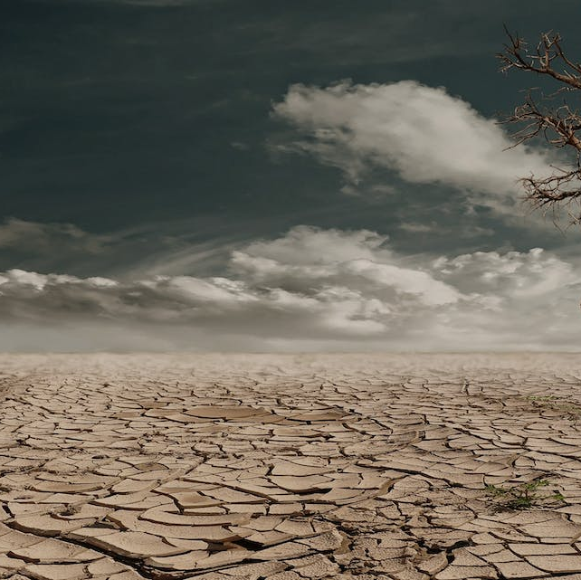

Reasons for Decreasing Water Levels
Effects of Climate Change
Drought Impact
Overuse of Resources
Climate change exacerbates water scarcity through altered precipitation patterns and increased evaporation rates.
Prolonged droughts lead to decreased water levels in rivers, lakes, and reservoirs, posing serious challenges for water availability.
Unsustainable use of water resources by industries, agriculture, and urban areas contributes to decreasing water levels.

Slide 4
Importance of Water
Ecosystem Balance
Essential for Agriculture
Human Hygiene
Water sustains diverse ecosystems, playing a pivotal role in supporting biodiversity and ecological balance.
Water is indispensable for crop cultivation, making its availability crucial for global food production.
Clean water is vital for maintaining hygiene, preventing waterborne diseases, and safeguarding public health.

Slide 5
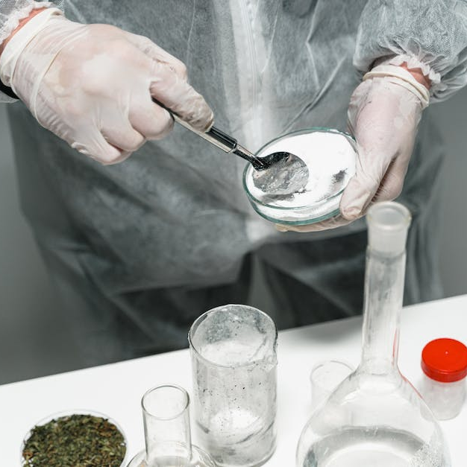
Water Quality Analysis Information
Testing Methods
Various techniques, such as chemical analysis and microbiological testing, are used to assess water quality.
Analysis Reports
Detailed reports provide insights into the presence of contaminants, pollutants, and overall water health.
Sampling Procedures
Systematic sampling protocols ensure accurate representation of water quality across different sources and locations.

Slide 6

Data Set File
Scientific Data Collection
Statistical Analysis
Researchers collect and analyze vast amounts of data to comprehensively evaluate water quality parameters and trends.
Statistical methods are applied to interpret data sets and identify patterns, correlations, and anomalies in water quality.
Laboratory Testing
Advanced laboratory facilities enable precise testing of water samples to quantify contaminant levels and assess risks.

Slide 7

Conclusion
Key Findings
Future Implications
Summarizing the main discoveries and observations from the water quality analysis process.
Considering the potential impacts and future steps based on the analyzed data and identified trends.
Actionable Recommendations
Concluding with clear and actionable suggestions to address water quality challenges and promote sustainable management.

Slide 8

THANKYOU

